Slide 1
TASK - 3
SUBIKSHA N
ENTERING/SOLVING A GIVEN WEBSITE USING BURPSUITE

Slide 2
report
Issue background - This is the standard description of the issue, and is the same for all issues of the same type.
Remediation background - This is the standard remediation advice, and is the same for all issues of the same type.
Issue detail - For some types of issues, this contains some further custom information about the particular issue, drawing attention to specific details that apply to the instance of the issue.
Remediation detail - For some types of issues, this contains further remediation advice, reflecting the particular features of the issue that were observed.
Vulnerability classifications - This contains the relevant mappings to the Common Weakness Enumeration (CWE) list.

Slide 3
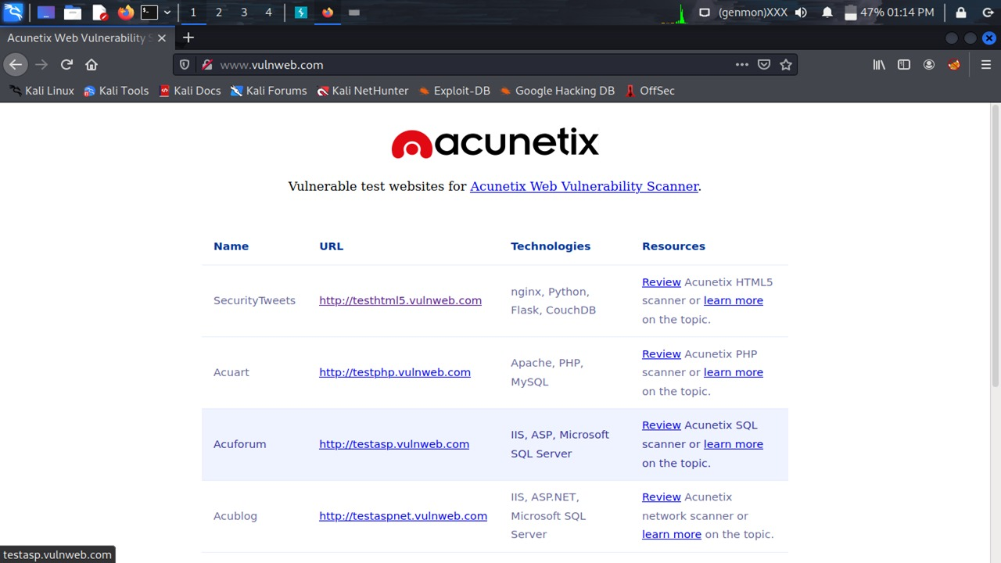

Slide 4
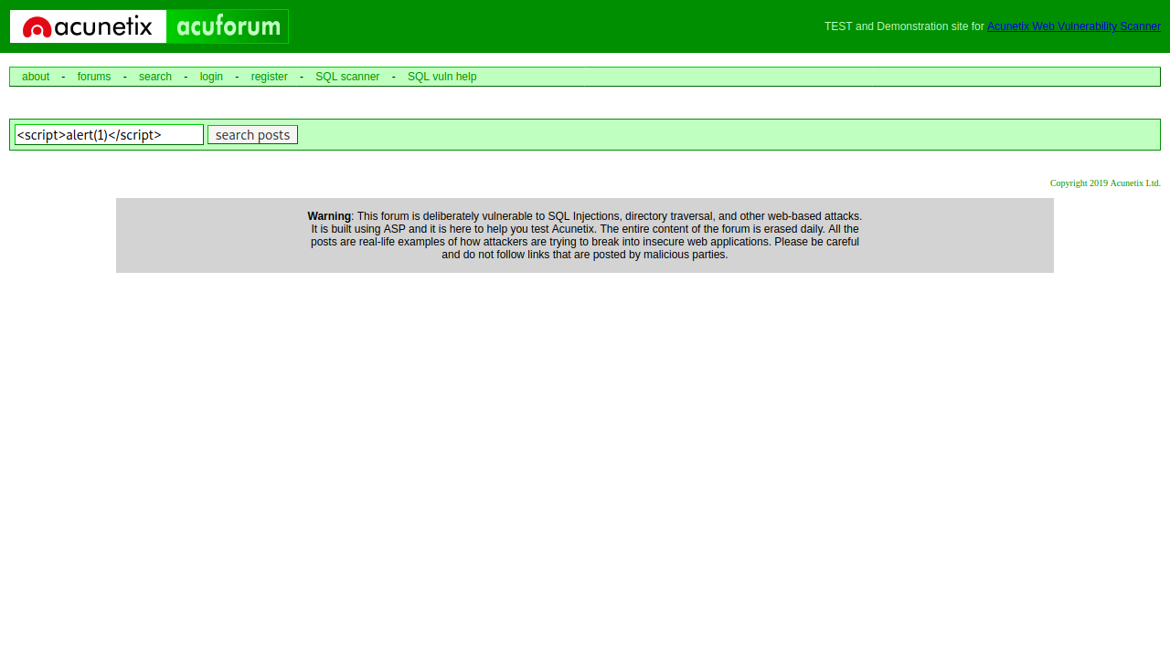

Slide 5
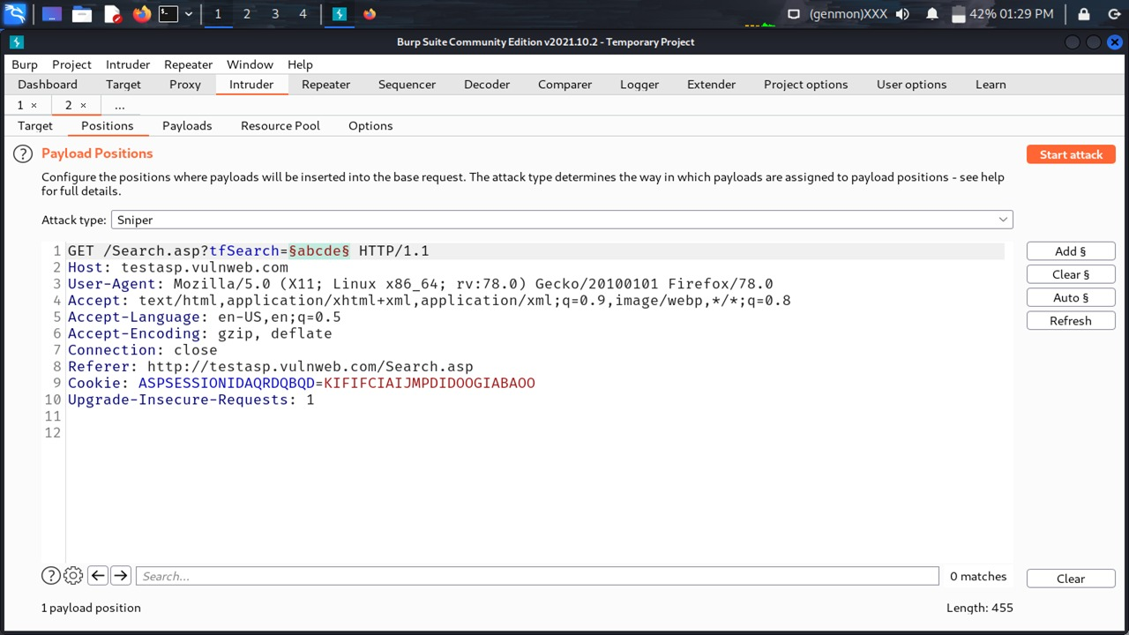

Slide 6
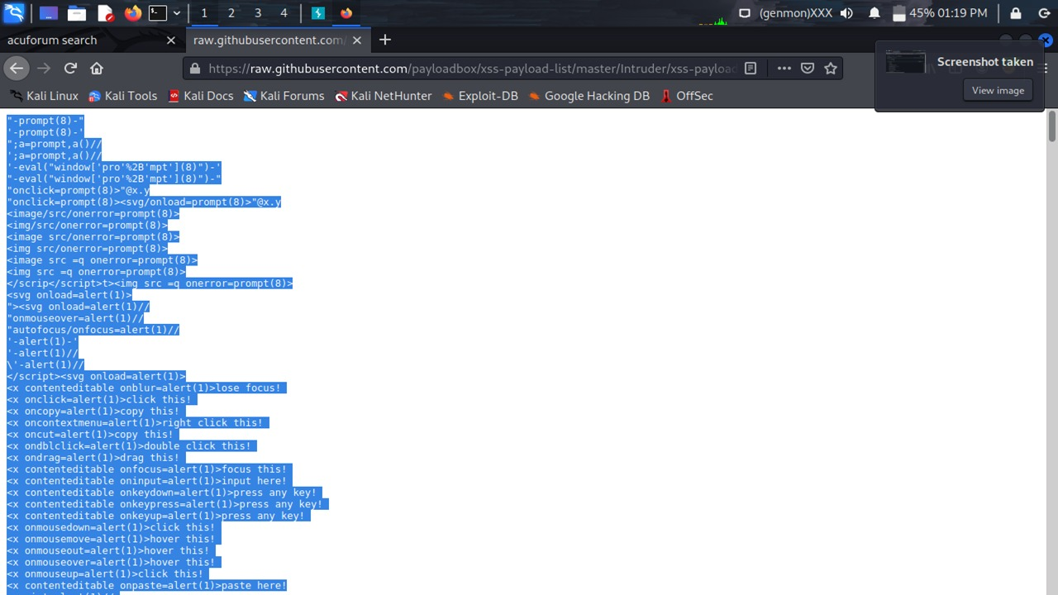

Slide 8
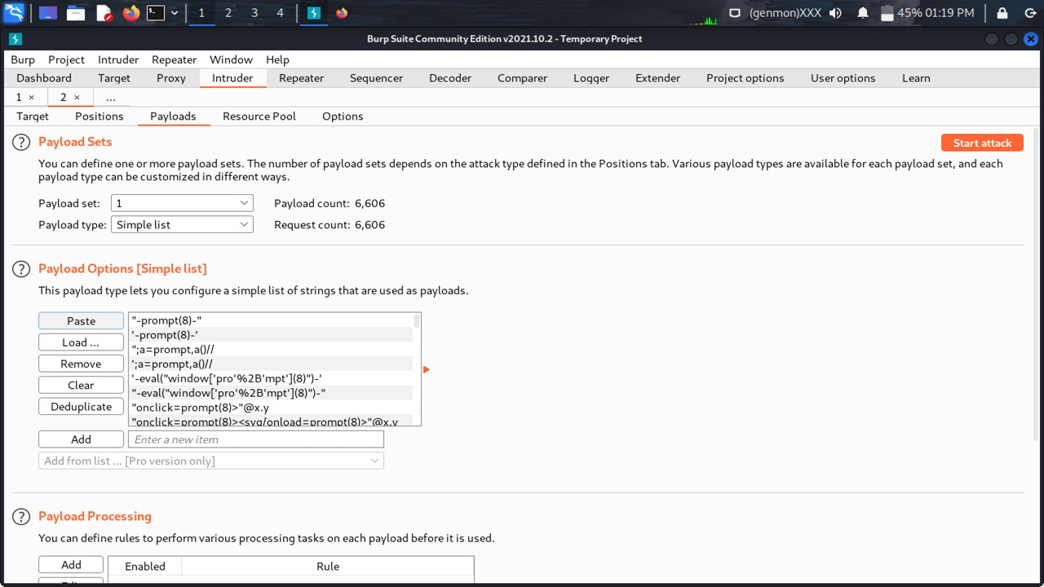

Slide 9
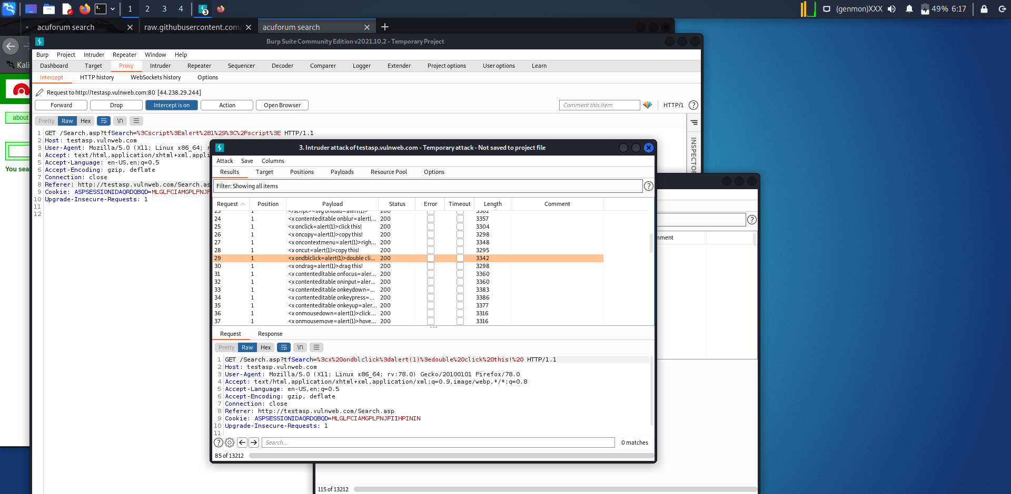

Slide 10
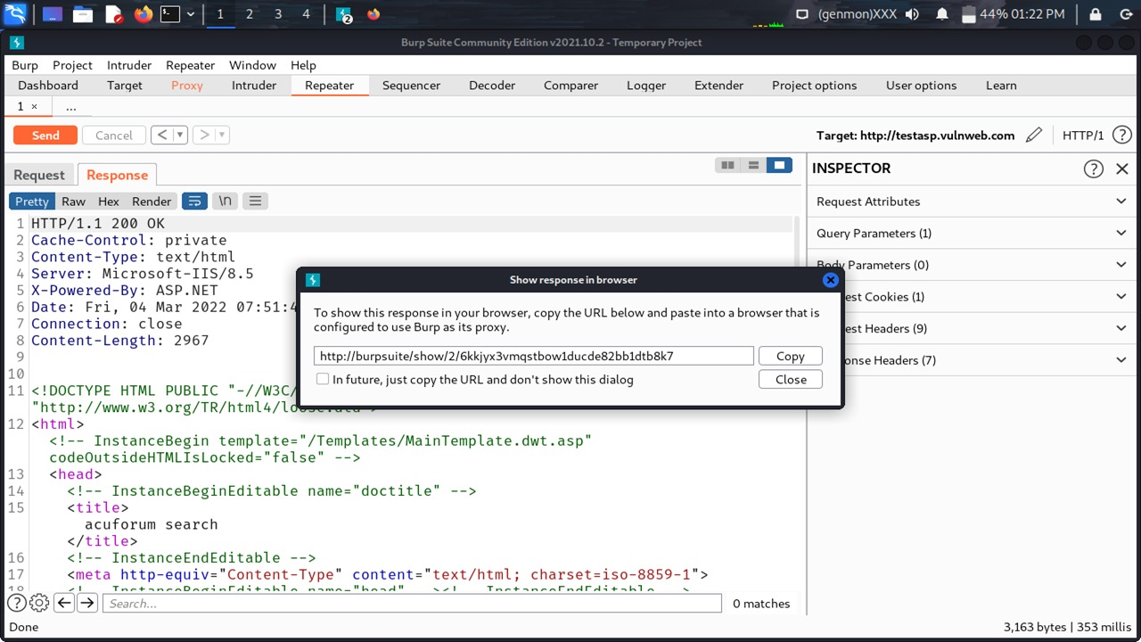

Slide 11
